Slide 1
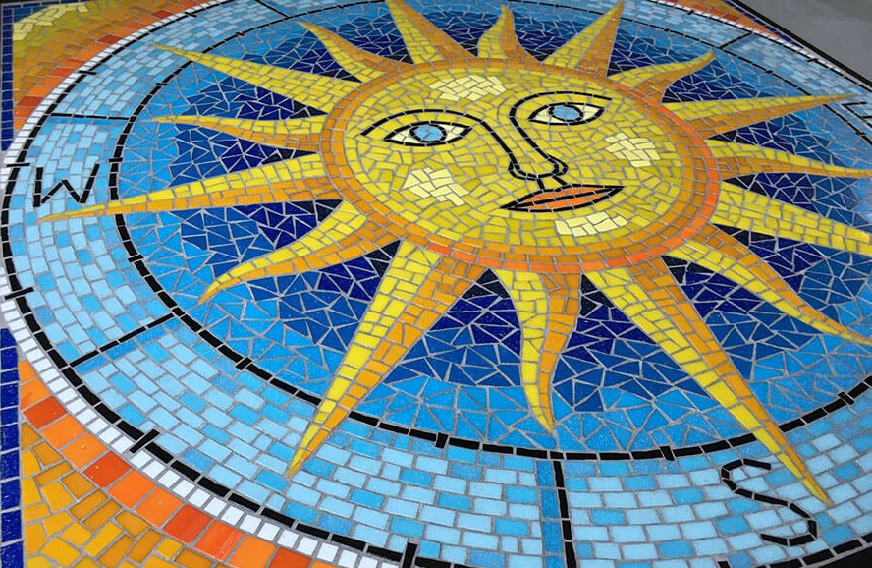
Personal Transformation
for a World in Crisis
—credit: Marie Powell’s “Sun Compass”

Slide 2
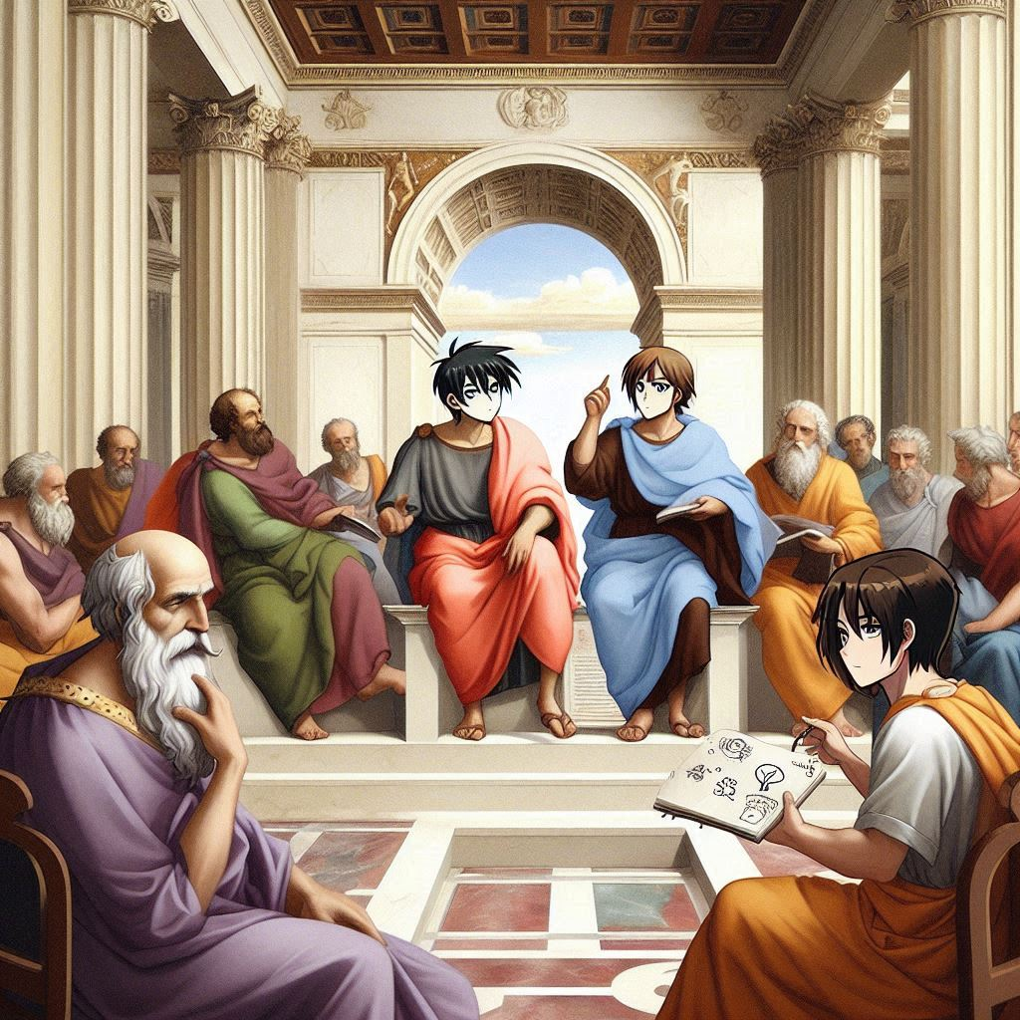
—credit: DALL-E 3

Slide 3
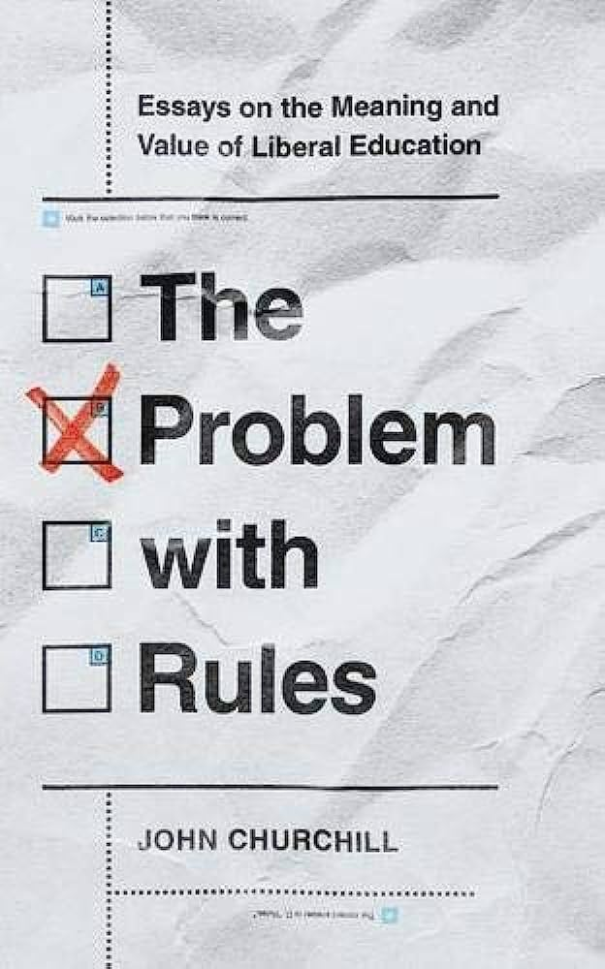
On “Personal Transformation”
Liberal learning effects a personal transformation by fostering dispositions that “lead to growth, to fuller humanity, to richer takes on things.”
“The difficulty” with this proposition “is that we can’t explain, not fully, anyway, the end we are aiming at and the transformation we propose to aim for, until the student is far down the road that leads there.”
—The Problem with Rules
(U Virginia P, 2021) pgs. 89, 87

Slide 4
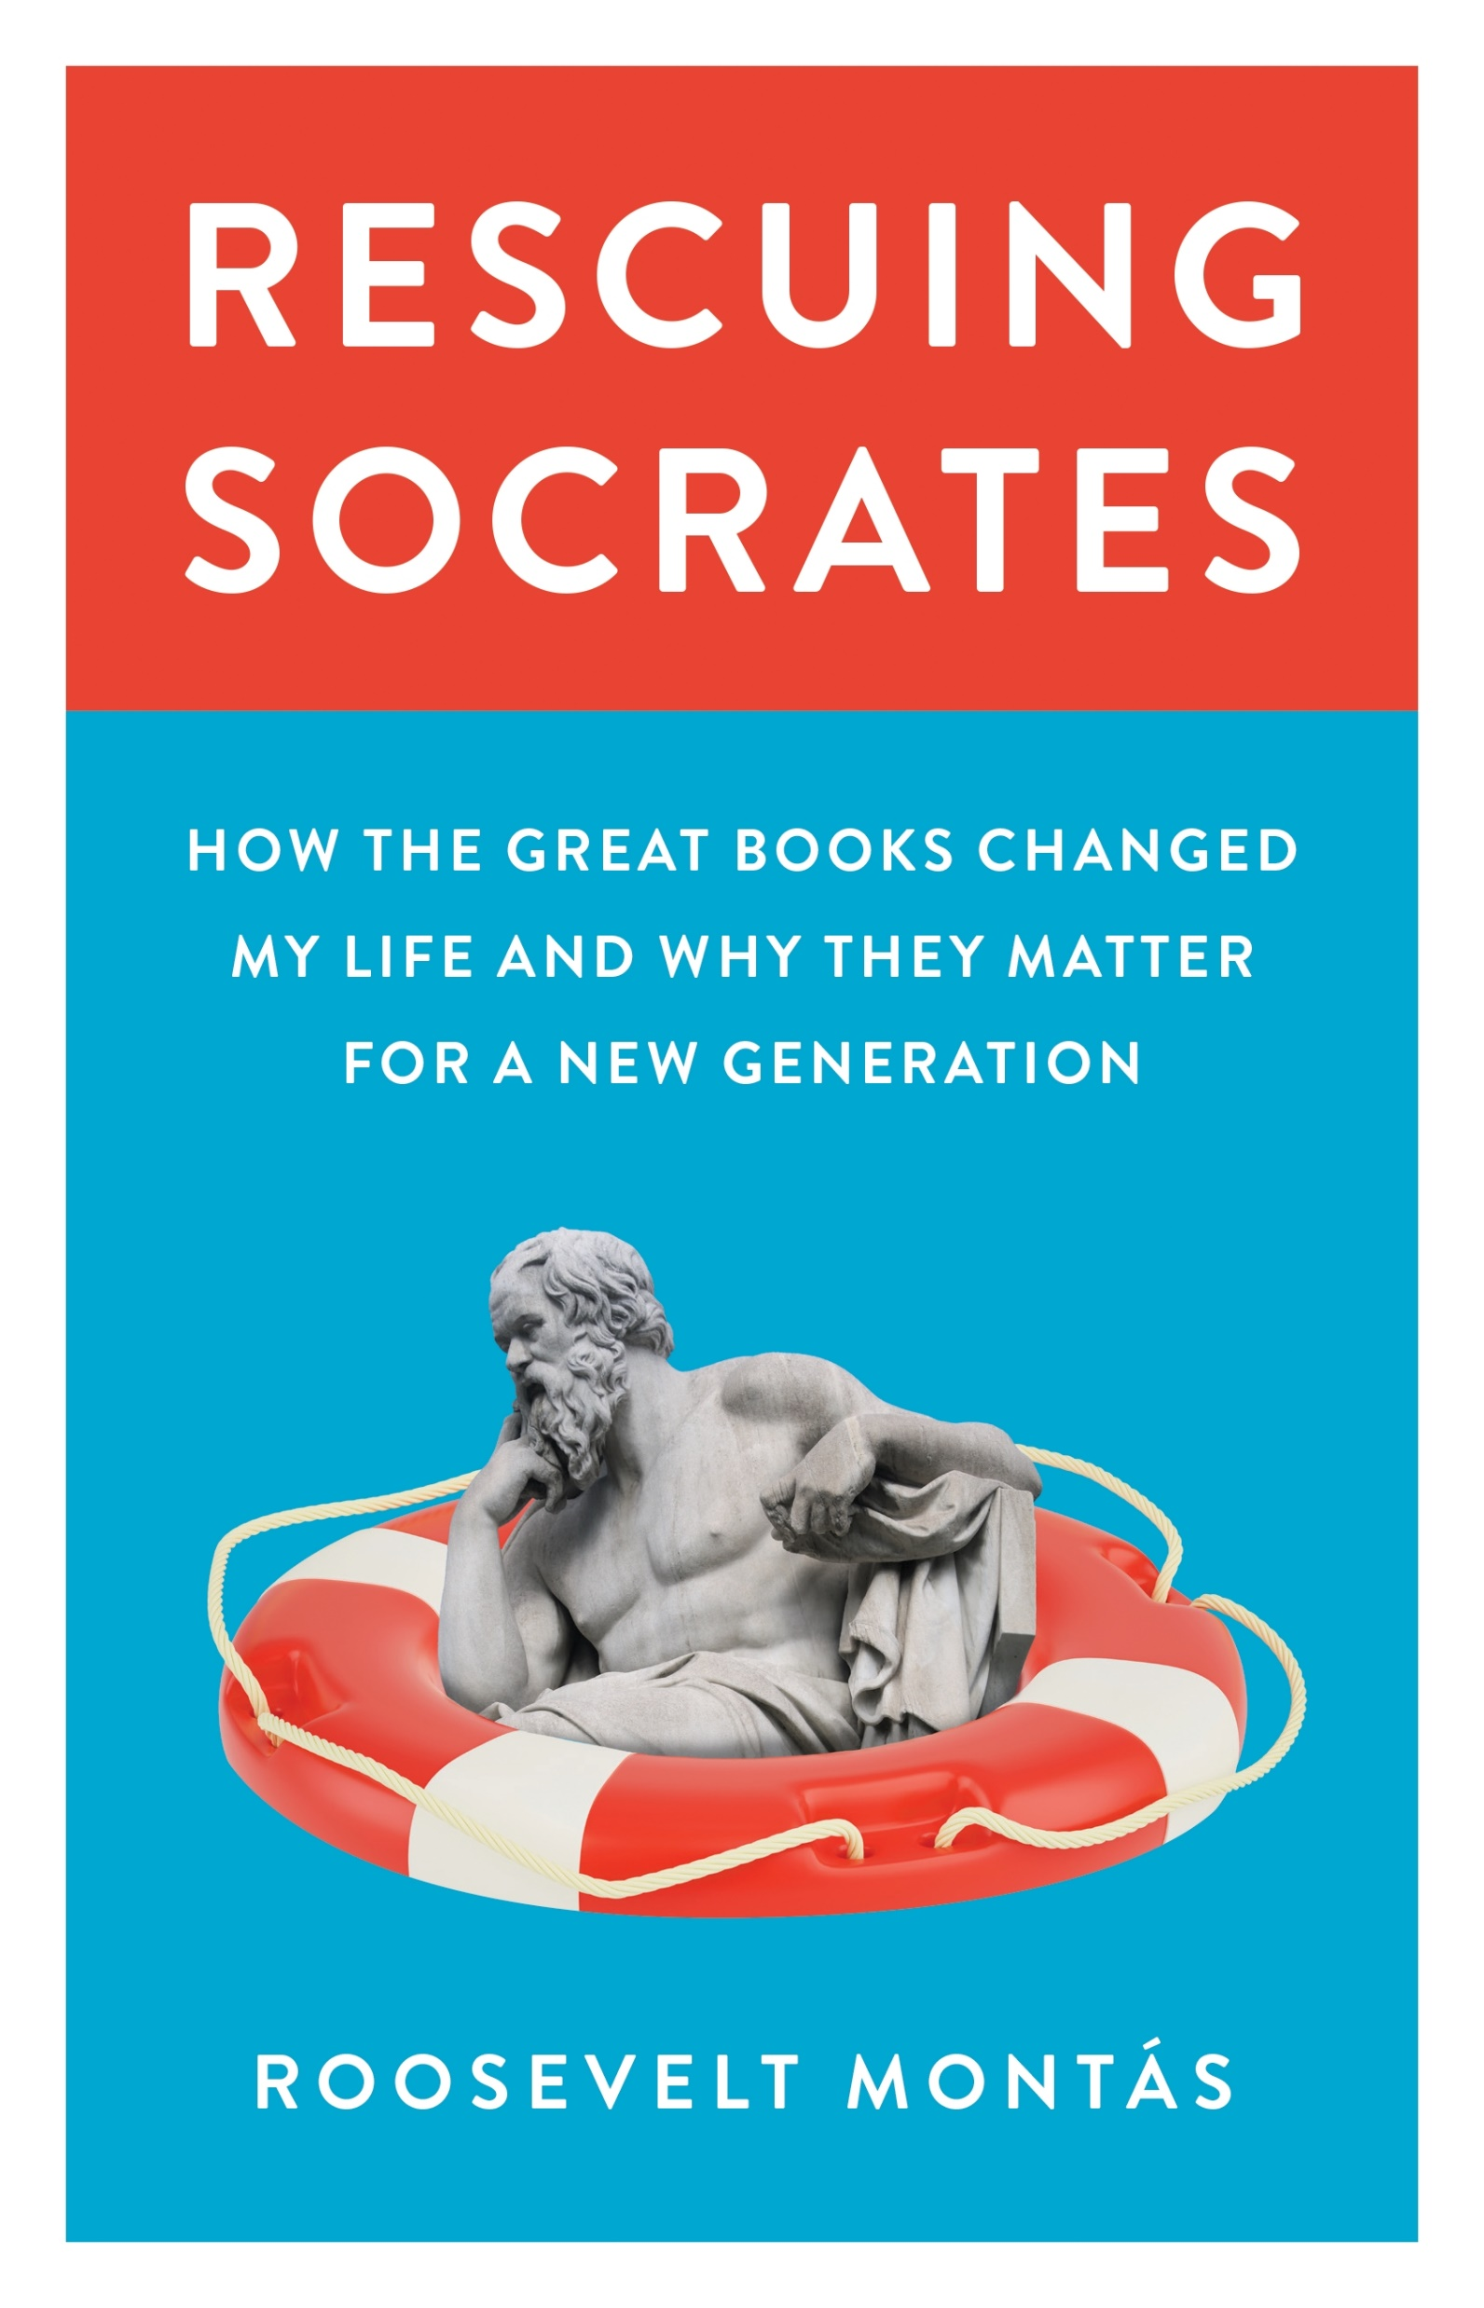
On “Personal Transformation”
“Yet the insights of that first year were more often about myself than about the books I was reading of the peers I was watching. I didn’t know then that this is precisely where the greatest value of a liberal education lies: in turning students’ eyes inward, into an exploration of their own humanity under the provocation of works that have proven their power to inspire just such self-reflection.”
—Rescuing Socrates
(Princeton UP, 2021) pg. 19

Slide 5

Questioning
1. Enduring questions to organize the syllabus
2. Normative question to initiate class session
3. Socratic questions to suffuse the class session
—credit: DALL-E 3

Slide 6
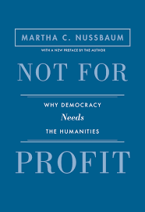
Why Self-Examination?
“The first problem with lack of self-examination is that it leads to unclarity about goals.”
“Another problem with people who fail to examine themselves is that they often prove all too easily influenced.”
“A further problem with people who lead the unexamined life is that they often treat one another disrespectfully.”
—Not for Profit
(Princeton UP, 2010) pgs. 49-50

Slide 7
Works Cited
Churchill, John. The Problem with Rules: Essays on the Meaning and Value of Liberal Education. University of Virginia Press, 2021.
“Grants Database.” The Teagle Foundation. www.teaglefoundation.org/How-We-Grant/Grants Database. Accessed 31 May 2024.
Montás, Roosevelt. Rescuing Socrates: How the Great Books Changed My Life and Why They Matter for a New Generation. Princeton University Press, 2021.
Nussbaum, Martha. Cultivating Humanity: A Classical Defense of Reform in Liberal Education. Harvard University Press, 1997.
---. Not for Profit: Why Democracy Needs the Humanities. University of Princeton Press, 2010.
“Request for Proposals.” The Teagle Foundation. https://www.teaglefoundation.org/Call-for-Proposals/RFPs/Cornerstone-Learning-for-Living. Accessed 2 June 2024.

Slide 8
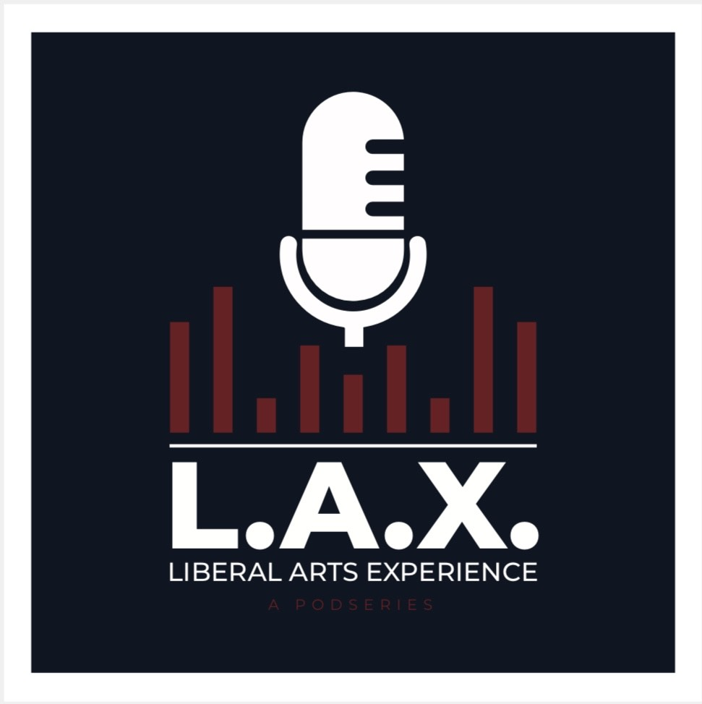
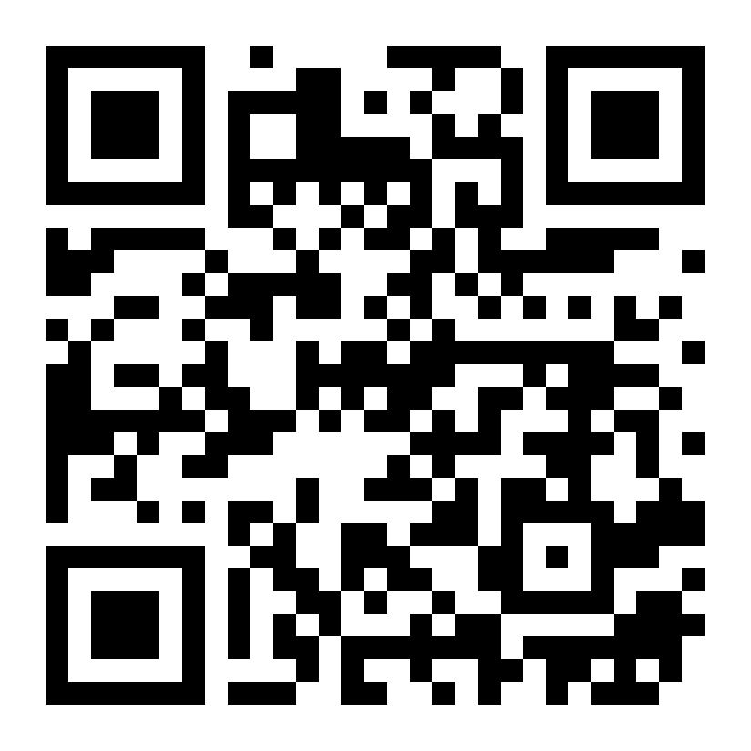
L.A.X.:
Liberal Arts Experience

Slide 9
Dall-E 3 Prompts
“plato and aristotle in raphael’s school of athens, but in anime style” on 30 May 2024.
“create an image of a college professor and a college student a book between them. The professor is asking a question. They are both grizzly bears” on 27 June 2024.

